Slide 1
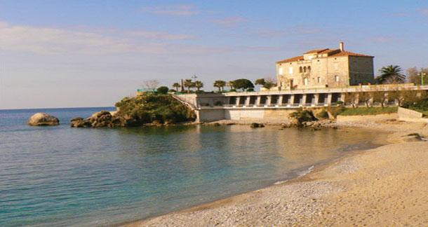
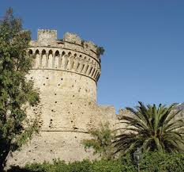
Belvedere Marittimo . . . sea, art and history

Slide 2
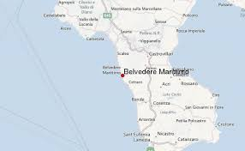
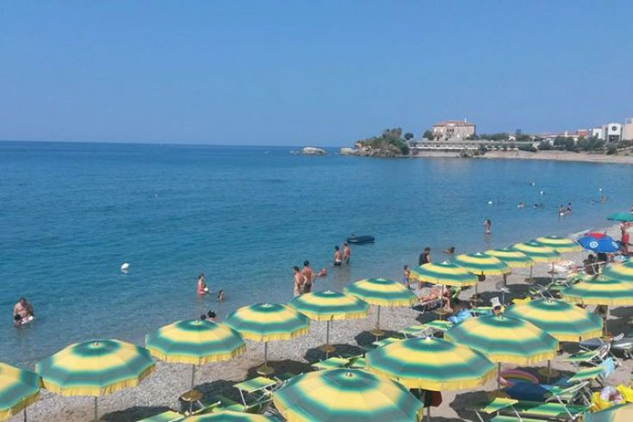
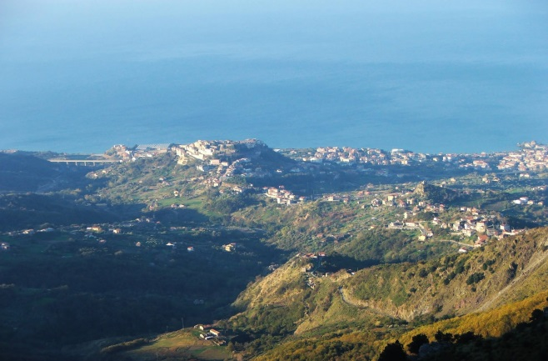
Belvedere Marittimo is a little town in Calabria in the South of Italy. Those who choose Belvedere as a destination for their holidays are lovers of the sea and the mountain.

Slide 3
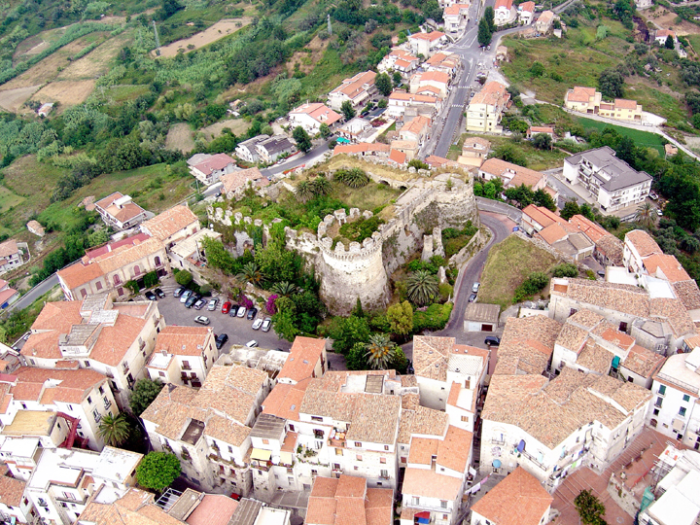
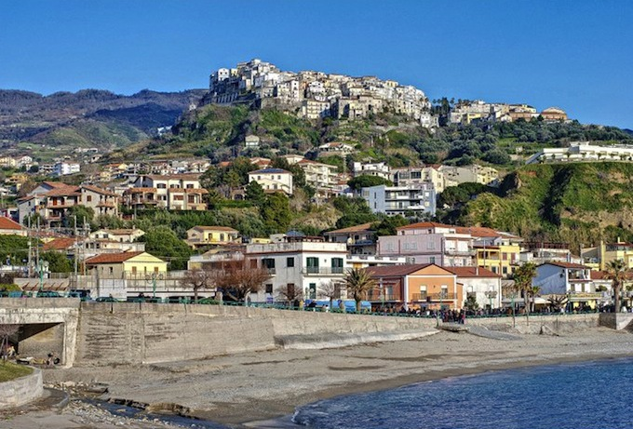
Belvedere Marittimo is divided in two areas: the old town
And the touristic and commercial area.

Slide 4
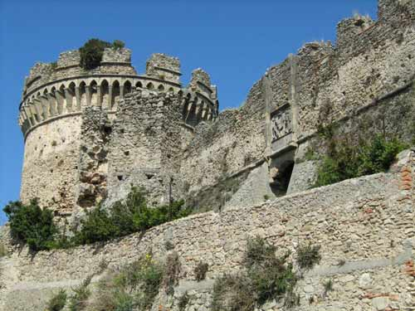
In the old town you can visit the Norman castle built around the year 1000 and restored by the Aragon during the Spanish domination.

Slide 5
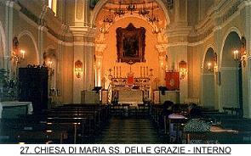
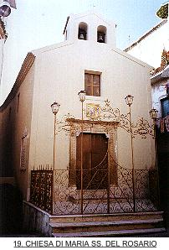
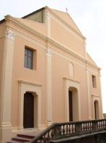
There are also old monuments: the Madonna delle Grazie church, The Rosario church and the Santa Maria del Popolo church.

Slide 6
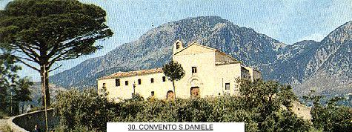
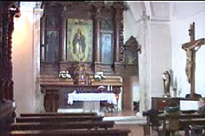
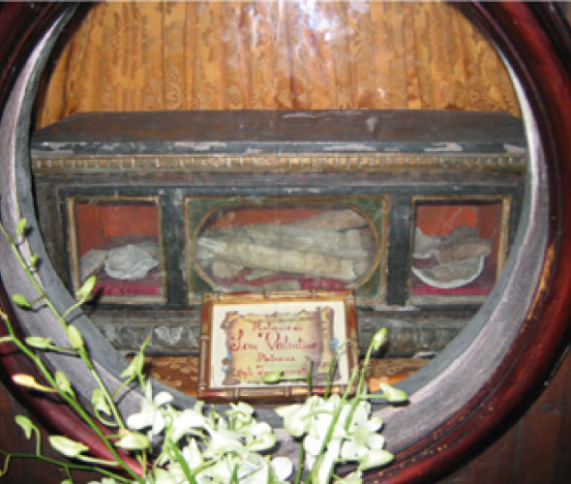
Belvedere Marittimo’s patron is St. Daniel Fasanella which is celebrated every year in October 13 and his statue stands in the Convent of the Capuchin Friars. In the Convent stands the St. Valentine’s relics for over 300 years and this is why Belvedere is called the «City of Love»

Slide 7
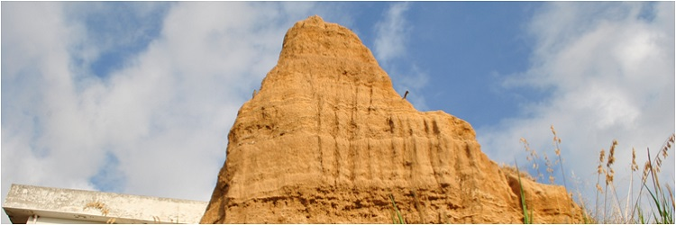
Another interesting attraction in Belvedere are the «Calanchi» (Badlands). Badlands are a type of dry terrain where the rocks and clay-rich soils have been eroded by wind and water. Real natural sculptures!

Slide 8
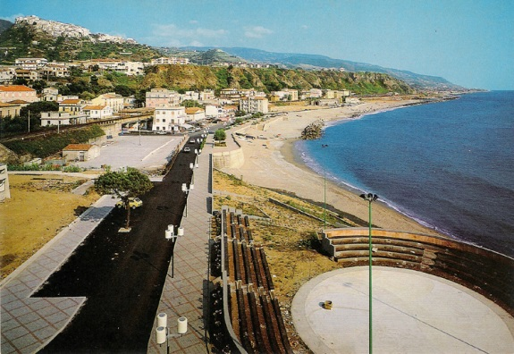
In Belvedere there is a beautiful seafront where people can relax with a nice walk.

Slide 9
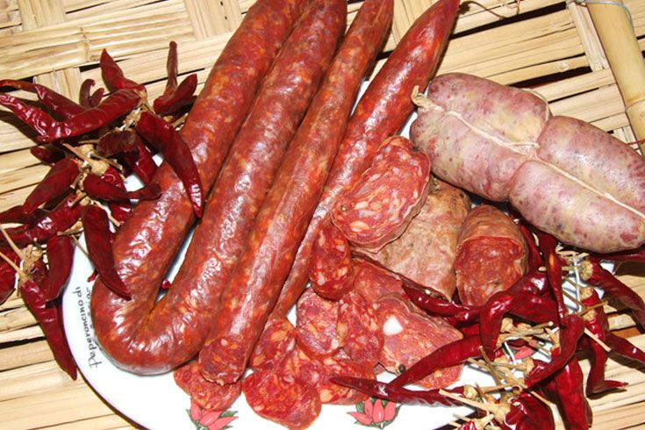
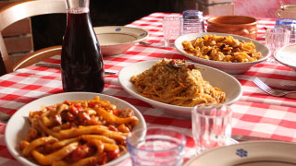
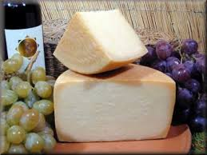
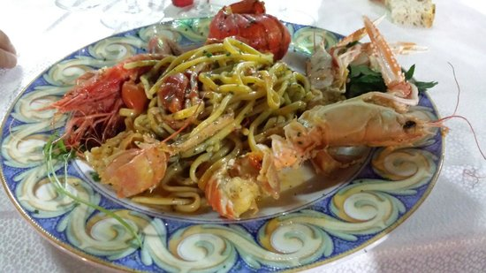
Belvedere Marittimo cuisine is very rich of dishes of meat, cheese and fish.

Slide 10
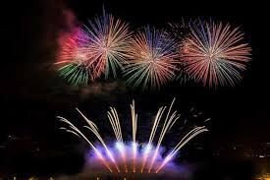
Since 2007, every year during the summer, in Belvedere is taking place the festival of fireworks «Note di fuoco». The greatest pyrotechnic Italian masters come to Belvedere and give light to the colors to the sound of music.

Slide 11
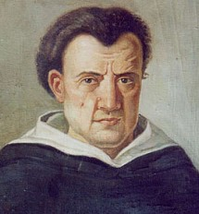
…And now some information about our school !!! Istituto Tommaso Campanella

Slide 12
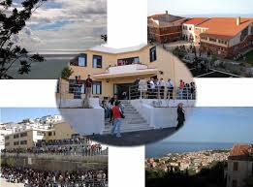
The Institute, founded in 1972, is a high school with multiple adresses. There are 5 Secondary schools: Classical High School Scientific High school Language High School Human Sciences High School Musical High School The Institute is located in the historical area of Belvedere Marittimo and was attended by over 700 students.

Slide 13
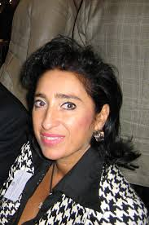
The main objective of our headteacher Maria Grazia Cianciulli with her staff of teachers is to promote human, moral, intellectual and social development of students

Slide 14
Bye-Bye Thanks to our school and Futuro Digitale for the great opportunity they give us. The Italian Group

